Slide 1

Introduction to OS
PASS
CS532: OS Foundations
Lab Assignment
Email id: faiyaz@pdx.edu
Partner email id: boyapati@pdx.edu

Slide 2
Instructions: Make a copy of this document, move your copy to your submissions folder and fill the document with your responses. Use the space on each slide to show your responses, and add additional slides as needed.
When ready for grading: complete the lab assignment submission form and include a link to your filled document

Slide 3
1. Which operating systems have you used prior to this class? List as many as you can think of.
Answer: I have used other OS such as Linux, MacOS and Windows in the past.

Slide 4
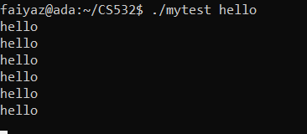
2. Compile and run the mytest.c program and run three concurrent copies of it as shown in the lecture video. use the "jobs" command to list the running mytest processes, and use the "kill" command to terminate them. Take a screenshot of the result and paste into the follow slide.
Answer:
Running the mytest.c program.

Slide 5
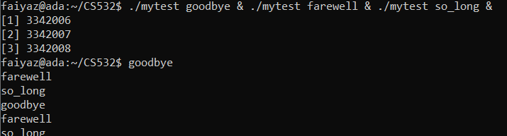

Running the three concurrent copies:
Good
List of mytest running processes(by using jobs command):

Slide 6
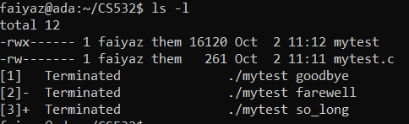
Terminating the processes using the kill command:

Slide 7
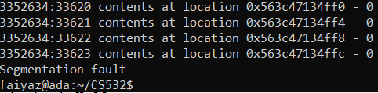
3. Compile and run the mytest2.c program as shown in the lecture slides. Run it until it crashes with a "Segmentation Fault". What is a segmentation fault?
Answer:
Segmentation Fault: Segmentation fault is caused when a program tries to access the memory that was not allowed/allocated to it. It causes program to crash.
Good

Slide 8
4. Describe how you might fix the two bugs in the mytest2.c code.
There are two bugs in the given code. We can fix them as below.
Check NULL for malloc return. If it is NULL then the memory was not allocated.
The another bug is segmentation fault. That is due to infinite loop. If we can make the loop till <10 times it can resolve the bug. The reason to choose 10 is, we have allocated 10 integer memory space.
Good

Slide 9
5. One of the most useful OS skills you can learn is to trace system calls for a program. On our department's linux servers you can use the "strace" program to trace all of the OS system calls called by a program. Use the strace program to trace all system calls called by the ./mytest2 program. Do it like this: "strace ./mytest2" This command will cause strace to run the ./mytest2 program AND trace all of the system calls called by ./mytest2. Collect the names of all of the system calls listed by strace and the number of times each syscall is called. Then use "man 2 <syscallname>" to get a one line description of each syscall. Record your results in the table on the following slide. Add extra rows/pages as needed.

Slide 10
Traced System Calls for #5
syscall name | One line description of this syscall | count
execve | Executes program with the given pathname | 1
arch_prctl | Set architecture specific thread state | 2
set_tid_address | Set pointer to thread ID | 1
openat | Open and possibly create a file | 2
newfstatat | To get file status | 3
set_robust_list | To set list of robust futexes | 1
getrandom | To obtain a series of random bytes | 1
OK, I am surprised that there are no calls to write()

Slide 11
Traced System Calls for #5
syscall name | One line description of this syscall | count
read | To read from a file descriptor | 1
close | To close a file descriptor | 2
mmap | It creates a new mapping in the virtual address space | 8
mprotect | To set protection on a region of memory | 3
munmap | To unmap files into memory | 1
brk | To change data segment size | 3
access | To check users permission for a file | 1
getpid | To get process identification | 1

